Slide 1
IPE Overview
Patient and Family centered care

Slide 2
Patient and Family Centered Care
https://www.youtube.com/watch?v=cDDWvj_q-o8

Slide 3
The lancet Health professionals for a new century: transforming education to strengthen health systems in an interdependent world
Glaring gaps and inequities in health persists both within and between countries
Fresh health challenges loom
New infections, environmental and behavioral risks at a time of rapid demographic and epidemiological transitions, threaten health security of all
Frenk, J., et al. (2010). Health professionals for a new century: Transforming education to strengthen health systems in an interdependent world. The Lancet.; 376; 1923-58.

Slide 4
The lancet Health professionals for a new century: transforming education to strengthen health systems in an interdependent
Professional education has not kept pace with these challenges
Redesign of professional health education is necessary and timely
Opportunities for mutual learning and joint solutions
Frenk, J., et al. (2010). Health professionals for a new century: Transforming education to strengthen health systems in an interdependent world. The Lancet.; 376; 1923-58.

Slide 5
Interprofessional education : a review of context, learning and the research agenda
Conclusion: Growing interest in IPE and in its education and research agenda to develop best practice models based on evidence of effectiveness
Requires educators and practicing health care professionals to collaborate to provide authentic learning experiences for students who are preparing to work together
Thistelthwaite, J. (2012). Interprofessional education: A review of context, learning and the research agenda. Medical Education; 46:58-70.

Slide 6
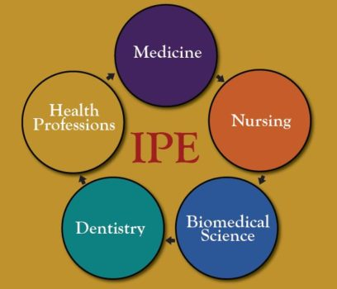
What is IPE
When students from two or more professions in health and social care learn together during all or part of their professional education with the object of cultivating collaborative practice for providing client-or patient centered health care
Vision: Transforming healthcare through interprofessional education and collaborative practice
Triple Aim of Health Care
(1) Improve the patient’s experience of care
(2) Improve the health of populations
(3) Decrease the cost of care
https://www.google.com/search?q=what+is+interprofessional+education&client=firefox-

Slide 7
Triple Aim
Improve the patient experience of care
Improve the health of populations
Reduce the per capita cost of health care

Slide 8
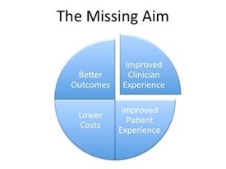
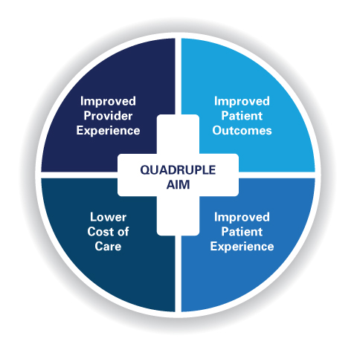
Quadruple Aim
https://www.google.com/search?q=what+is+interprofessional+education&client=firefox-

Slide 9
Quadruple Aim

Slide 10
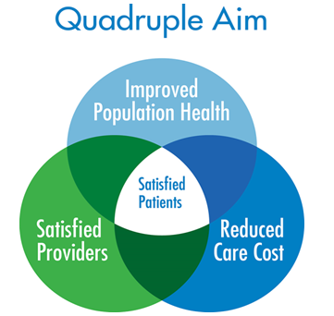
Quadruple aim
https://www.google.com/search?q=what+is+interprofessional+education&client=firefox-

Slide 11
How we measure up
National Scorecard on U.S. Health System Performance provided by the Commonwealth Fund Commission on a High Performance Health System
Scorecard measures health system across 42 Key Indicators of health care quality, access, efficiency, equity, and healthy lives.
In particular, the report notes significant erosion in access to care and affordability of care, as health care costs have risen far faster than family incomes.
The Commonwealth Fund; https://www.commonwealthfund.org/publications/newsletter-article/new-national-scorecard-health-system-performance-us-gets-only-64

Slide 12
Why IPE
U.S health care system overall score of 66% (2006)
Expenditures are far higher than those of other developed countries, results are no better
Spending nearly double than that of the next most costly nation
U.S ranks:
31st among nations on life expectancy
36th on infant mortality
28th on male healthy life-expectancy
29th on female healthy life expectancy
Berwick, Nolan, & Whittington (2008) The Triple Aim: Care. Health, and Cost

Slide 13
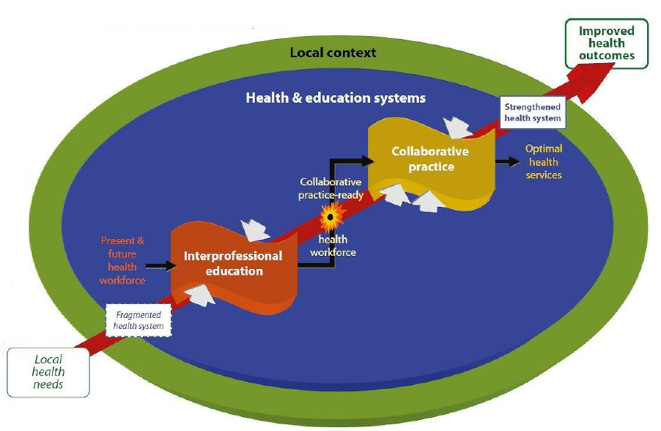
Why IPE
https://www.google.com/search?q=what+is+interprofessional+education&client=firefox

Slide 14
IPE Goals
To improve knowledge, skills, and attitudes necessary for graduates to contribute toward improving the patient care experience, improving the health of the population, and decreasing the cost of care through a longitudinal interprofessional education and collaborative practice curricular model.
To create a patient and family centered collaborative practice workforce prepared to impact health related outcomes.
To create and dynamically adapt the content of the triple aim curriculum to focus upon and address the local and regional social determinants of health impacting the State of Arkansas.
To participate in a triple aim curriculum graduation expectation that contributes directly toward the institutional mission within the realms of education, clinical practice, and research.
To meet and exceed compliance with relevant professional and accreditation standards.

Slide 15
IPE General Competencies
Values/Ethics – Work with individuals of other professions to maintain a climate of mutual respect and shared values.
Roles and Responsibilities – Use the knowledge of one’s own role and those of other professions to appropriately assess and address the healthcare needs of the patients and populations served.
Communication – Communicate with patients, families, communities, and other health professionals in a responsive and responsible manner that supports a team approach to the maintenance of health and the treatment of disease.
Teams and Teamwork – Apply relationship-building values and the principles of team dynamics to perform effectively in different team roles to plan and deliver patient-/population-centered care that is safe, timely, efficient, effective, and equitable.
Notes:
IPE activates are designed to address the general competencies, we can discuss examples

Slide 16
Ipe Beginnings
2009 six national associations of schools of health professions formed a collaborative to promote and encourage constituent efforts that would advance substantive interprofessional learning experiences.

Slide 17
Professions Represented in 2009
Dentistry, Nursing, Medicine, Osteopathic Medicine, Pharmacy, and Public Health

Slide 18
9 new members in 2016
American Association of Colleges of Podiatric Medicine; American Council of Academic Physical Therapy; American Occupational Therapy Association; American Psychological Association; Association of American Veterinary Medical Colleges; Association of Schools and Colleges of Optometry; Association of Schools of Allied Health Professions; Council on Social Work Education; and Physician Assistant Education Association

Slide 19
Goals of IPE
Prepare future health professionals for enhanced team-based care of patients
Improve Population Outcomes
Notes:
In corporation with the triple/quadruple aim

Slide 20
Why we need collaboration
Developing leaders in interprofessional education who have
The knowledge, skills and attitudes to teach both learners
and fellow colleagues the art and science of working
collaboratively for care.
https://www.google.com/search?q=what+is+interprofessional+education&client=firefox

Slide 21
COCA Requirement
6.8 Interprofessional Education for Collaborative Practice
COM faculty must ensure that the core curriculum prepares osteopathic medical students to function collaboratively on health care teams, adhering to the IPEC core competencies, by providing opportunities, in each year of the curriculum, to learn in academic and clinical environments that permit interaction with students enrolled in other health professions degree programs.
Commission on Osteopathic Accreditation (July 2019)

Slide 22
CODA dental hygiene standards
2-15 Graduates must be competent in communicating and collaborating with other members of the health care team to support comprehensive patient care.
Intent:
The ability to communicate verbally and in written form is basic to the safe and effective provision of oral health services for diverse populations. Dental Hygienists should recognize the cultural influences impacting the delivery of health services to individuals and communities (i.e. health status, health services and health beliefs). Students should understand the roles of members of the health-care team and have educational experiences that involve working with other health-care professional students and practitioners.
Examples of evidence to demonstrate compliance may include:
• student experiences demonstrating the ability to communicate and collaborate effectively with a variety of individuals, groups and health care providers.
• examples of individual and community-based oral health projects implemented by students during the previous academic year
• evaluation mechanisms designed to assess knowledge and performance of interdisciplinary communication and collaboration
CODA Accreditation Standards for Dental Hygiene Education (2018)

Slide 23
ADEA Core Competencies
Health Care Policy, Interprofessional Collaboration, and Advocacy refers to the understanding of policy and its development, the value of collegiality and interprofessional collaboration, and advocacy related to the promotion of health, education, and the profession of dental hygiene.
Journal of Dental Education (2012) Volume 76, 7

Slide 24
CNEA Standard II culture of integrity and accountability
The nursing program seeks and utilizes feedback from communities of interest to inform program development and decision-making about the educational preparation of students.
Partnerships among communities of interest and the nursing program promote a sense of cohesiveness and intra- and interprofessional collaboration, leading to contemporary experiential learning experiences for students with a goal of preparing a diverse, competent workforce
NLN Commission for Nursing Education Accreditation (2016)

Slide 25
How do we heal medicine
Our medical systems are broken. Doctors are capable of extraordinary (and expensive) treatments, but they are losing their core focus: actually treating people. Doctor and writer Atul Gawande suggests we take a step back and look at new ways to do medicine – with fewer cowboys and more pit crews.
Atul Gawande TED2012
ttps://www.ted.com/talks/atul_gawande_how_do_we_heal_medicine?language=en

Slide 26
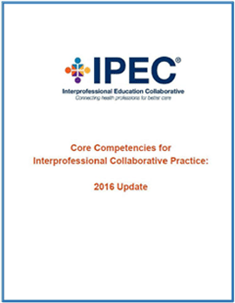
For More information

Slide 27
Resources
https://www.youtube.com/watch?v=cDDWvj_q-o8
Frenk, J., et al. ()2010). Health professionals for a new century: Transforming education to strengthen health systems in an interdependent world. The Lancet.; 376; 1923-58.
Thistelthwaite, J. (2012). Interprofessional education: A review of context, learning and the research agenda. Medical Education; 46:58-70.
Berwick, D.M. et al. (2008) Health Aff: 27; 759-769
Bodenheimer, T. & Sinsky, C. (2014) Annals of Family Medicine: 12;573-576.
The Commonwealth Fund; https://www.commonwealthfund.org/publications/newsletter-article/new-national-scorecard-health-system-performance-us-gets-only-64
Berwick, Nolan, & Whittington (2008) The Triple Aim: Care. Health, and Cost

Slide 28
Resources
Commission on Osteopathic Accreditation (July 2019)
CODA Accreditation Standards for Dental Hygiene Education (2018)
Journal of Dental Education (2012) Volume 76, 7
NLN Commission for Nursing Education Accreditation (2016)
ttps://www.ted.com/talks/atul_gawande_how_do_we_heal_medicine?language=en

