Slide 1
Are we ready for interprofessional education?
Of course we are!!
Melissa Efurd, Ed.D
Associate Dean of Academic Affairs
Arkansas Colleges of Health Education
Tracey Zeiner, OTD, OTR/L
Assistant Professor - School of Occupational Therapy
Arkansas Colleges of Health Education

Slide 2
RIPLS Readiness for Interprofessional Learning Scale
(adapted from McFayden et al. 2005)
Results from faculty retreat survey
May 2020

Slide 3
RIPLS Results Demographics
N = 20
Age: 15% 30s, 30% 40s, 30% 50s, 15% 60s, 10% 70s
Gender: 60% male, 40% female
Program: 80% DO, 20% PT
Years in HC education: 1-5 35%
6-10 10%
11+ 55%

Slide 4
RIPLS Results Other HC professionals you have worked with:
95% medical doctors
80% doctors of osteopathy
75% nurses
70% pharmacists
physician assistants
65% physical therapists
55% occupational therapists
social workers
50% speech language pathologists

Slide 5
RIPLS Results What does IPE mean to you?
Collaboration, learning from each other, developing a true appreciation of what other disciplines bring to the table and knowledge of when to bring others in to provide optimal patient care
Health care is teamwork and we need to be in tune.
learning about the roles, responsibilities, and contributions of other members of the healthcare team
Sharing an educational experience with a professional in a different field.
cross-discipline
and joint learning
opportunities
Different health occupation training programs working together to solve and/or address patient problems
Collaboration between professions.
The opportunity to integrate patient care with other specialists dynamically for a whole patient approach to treatment or diagnosis
learning the importance of communicating with other disciplines
Teaching students how to work with other professions in a meaningful way that holds value to the patients, HC workers, & others
Showing specialists what other specialties do

Slide 6
RIPLS Results Barriers to IPE @ ACHE:
Faculty inadequacy
Not enough faculty to teach our own, let alone work with other programs
Exclusion of others because they may think differently
Cliques / professional pride
Separate buildings
Limited clinical experiences
Scheduling conflicts / logistics
No specific actionable plan, purpose, or outcome
Limited funding / resources
Added responsibility
Personality conflicts
IPE is being forced; it should be natural
Lack of faculty
Faculty turnover

Slide 7
RIPLS Results Supports to IPE @ ACHE:
Administration, faculty, & staff
Leadership support
Close proximity of faculty & administration
Faculty from different programs who interact with each other
Accreditation expectations
Physical proximity
Self-motivated & team-oriented people
Simulation & standardized patient settings
Environments that support large groups & small breakout sessions
Shared resources
Enthusiasm / interest
Awareness of IPE benefits
Students’ interest in inclusivity
New programs are starting & can develop IPE experiences early on

Slide 8
4 Subscales Scoring 1-5 with a higher number indicating a greater readiness for IPE
Teamwork & Collaboration 4.58 Attitudes regarding the effect of cooperative learning
Negative Professional Identity *4.37 Point to lack of value placed on cooperative learning
Positive Professional Identity 4.46 Measures value placed on shared learning
Roles & Responsibilities *3.48 Unclear or distorted sense of what one’s professional roles might be
OVERALL MEAN 4.35
* Required reverse coding

Slide 9
Resources for the ripls
McFadyen, A.K., Webster, V., Strachan, K., Figgins, E., Browmn, H., & Mckechnie, J. (2005). The Readiness for Interprofessional Learning Scale: A possible more stable sub-scale model for the original version of RIPLS. Journal of Interprofessional Care, MC Medical Education, 18(1), 125. https://doi.org/10.1186/s12909-018-1248-5
Visser, C., Wilschut, J. A., Isik, U., van der Burgt, S., Croiset, G., & Kusurkar, R. A. (2018). The Association of Readiness for Interprofessional Learning with empathy, motivation and professional identity development in medical students. BMC Medical Education, 18(1), 125. https://doi.org/10.1186/s12909-018-1248-5

Slide 10
IPE Overview
Melissa Efurd, Ed.D
Associate Dean of Academic Affairs
Arkansas Colleges of Health Education

Slide 11
IPE Overview
“Above all, I believe that teaching is an honor: to be able to influence, motivate and encourage the upcoming generation of professionals in the health sciences.” author unknown

Slide 12
Objectives
Define IPE
Discuss the goals and benefits
Discuss the IPE Competencies
Formulate ideas for future IPE events/activities
Notes:
Today we will define and discuss IPE, the origins, competencies and hopefully have time to brainstorm for future events and activities.

Slide 13
SDOH
The strongest determinants of your health are not your genes, gender, how far you can walk or even if you have health insurance. The strongest factors that shape your health are the conditions in which you are born, grow, live, work and age.
The first wealth is health (Ralph Waldo Emerson)
Health and Wealth are closely connected in the United States
Ray Haney, SDOH Talk Business 6.25.2020, President and CEO of the Arkansas Foundations for Medical Care
Notes:
Known as SDOH they include your education, socioeconomic status, jobs, access to health care, race, ethnicity, gender, family structure, and the conditions of your neighborhoods and work environment. High rates of COVID – 19 are related to unhealthy SDOH.

Slide 14
SDOH
Unless there are changes, U.S health care will continue to spend vast sums of money on acute health care problems with only third-world results. “
The majority of health care costs are spent on 5% to 10% of our population. Referred to as “high need high cost” patients.
Ray Haney, SDOH Talk Business 6.25.2020, President and CEO of the Arkansas Foundations for Medical Care
Notes:
We have an opportunity to create change in the health care system by the education of our students. IPE is one piece of the complex puzzle. The HNHC patients are very sick and require long-term or extensive care. Best care is a team approach.

Slide 15
Why IPE
U.S health care system overall score of 66% (2006)
Expenditures are far higher than those of other developed countries, results are no better
Spending nearly double than that of the next most costly nation
U.S ranks:
31st among nations on life expectancy
36th on infant mortality
28th on male healthy life-expectancy
29th on female healthy life expectancy
Berwick, Nolan, & Whittington (2008) The Triple Aim: Care. Health, and Cost
Notes:
IPE has never been more relevant than it is today. Amid the pandemic, data show that Black and Latinx Americans are contracting and dying at higher rates than white Americans (Commonwealth Fund, 2020). Dr. Berwick , is a former Administrator for the Centers for Medicare and Medicaid Services. Prior to that, he was President and CEO of the Institute of Healthcare Improvement a not-for-profit organization. Books: Escape Fire, On Quality, and MORE

Slide 16
How we measure up
National Scorecard on U.S. Health System Performance provided by the Commonwealth Fund Commission on a High-Performance Health System
Scorecard measures health system across 42 Key Indicators of health care quality, access, efficiency, equity, and healthy lives.
In particular, the report notes significant erosion in access to care and affordability of care, as health care costs have risen far faster than family incomes.
The Commonwealth Fund; https://www.commonwealthfund.org/publications/newsletter-article/new-national-scorecard-health-system-performance-us-gets-only-64
Notes:
In reviewing annual Commonwealth Fund reports, the scorecard is not improving. As we are aware, the corona virus is not selective, but we know the HNHC patients have an increased rate of complications and death.

Slide 17
Why IPE
https://www.google.com/search?q=what+is+interprofessional+education&client=firefox
Notes:
A visual o follow the IPE trajectory.

Slide 18
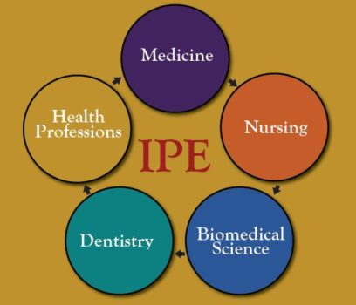
What is IPE
When students from two or more professions in health and social care learn together during all or part of their professional education with the object of cultivating collaborative practice for providing client-or patient centered health care
Vision: Transforming healthcare through interprofessional education and collaborative practice
Triple Aim of Health Care
(1) Improve the patient’s experience of care
(2) Improve the health of populations
(3) Decrease the cost of care
https://www.google.com/search?q=what+is+interprofessional+education&client=firefox-
Notes:
Students from two or more professions learn(ing) about, from, and with each other to enable effective collaboration and improve health outcomes. IPE is a necessary step in preparing a collaborative practice-ready health workforce that is better prepared to respond to local health needs.

Slide 19
IPE Goals
To improve knowledge, skills, and attitudes necessary for graduates to contribute toward improving the patient care experience, improving the health of the population, and decreasing the cost of care through a longitudinal interprofessional education and collaborative practice curricular model.
To create a patient and family centered collaborative practice workforce prepared to impact health related outcomes.
To create and dynamically adapt the content of the triple aim curriculum to focus upon and address the local and regional social determinants of health impacting the State of Arkansas.
To participate in a triple aim curriculum graduation expectation that contributes directly toward the institutional mission within the realms of education, clinical practice, and research.
To meet and exceed compliance with relevant professional and accreditation standards.
Notes:
The focus on improving the health care system by providing higher quality, low-cost care has intensified the need for providing care through interdisciplinary teams. Research has demonstrated improved patient outcomes associated with interprofessional care.

Slide 20
Quadruple Aim
Notes:
Research findings suggest that medical students who learn alongside students from a greater number of other health professionals also report having a better understanding of collaborative, interprofessional care of patients, and significantly higher levels of overall satisfaction with their medical training.

Slide 21
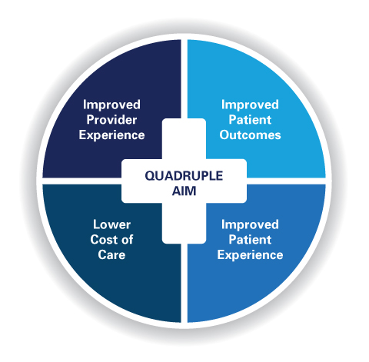
Quadruple Aim
https://www.google.com/search?q=what+is+interprofessional+education&client=firefox-
Notes:
When discussing IPE, it is important to go beyond students sharing knowledge. Addressing the social determinants of health, addressing health disparities, and providing patient and family centered care are the core elements of IPE.

Slide 22
Quadruple aim
https://www.google.com/search?q=what+is+interprofessional+education&client=firefox-
Notes:
When students experience a greater breadth of IPE opportunities, they perceive their medical education to be of higher quality.

Slide 23
Ipe Beginnings
2009 six national associations of schools of health professions formed a collaborative to promote and encourage constituent efforts that would advance substantive interprofessional learning experiences.
Dentistry, Nursing, Allopathic Medicine, Osteopathic Medicine, Pharmacy, and Public Health

Slide 24
9 new members in 2016
American Association of Colleges of Podiatric Medicine; American Council of Academic Physical Therapy; American Occupational Therapy Association; American Psychological Association; Association of American Veterinary Medical Colleges; Association of Schools and Colleges of Optometry; Association of Schools of Allied Health Professions; Council on Social Work Education; and Physician Assistant Education Association
Notes:
All ACHE Programs are represented.

Slide 25
Why we need collaboration
Developing leaders in interprofessional education who have
The knowledge, skills and attitudes to teach both learners
and fellow colleagues the art and science of working
collaboratively for care.
https://www.google.com/search?q=what+is+interprofessional+education&client=firefox
Notes:
All the ACHE programs need IPE for accreditation.

Slide 26
IPE General Competencies
Values/Ethics – Work with individuals of other professions to maintain a climate of mutual respect and shared values.
Roles and Responsibilities – Use the knowledge of one’s own role and those of other professions to appropriately assess and address the healthcare needs of the patients and populations served.
Communication – Communicate with patients, families, communities, and other health professionals in a responsive and responsible manner that supports a team approach to the maintenance of health and the treatment of disease.
Teams and Teamwork – Apply relationship-building values and the principles of team dynamics to perform effectively in different team roles to plan and deliver patient-/population-centered care that is safe, timely, efficient, effective, and equitable.
Notes:
IPE activities are designed to address the general competencies, we can discuss examples

Slide 27
COCA Standard
6.8 Interprofessional Education for Collaborative Practice
COM faculty must ensure that the core curriculum prepares osteopathic medical students to function collaboratively on health care teams, adhering to the IPEC core competencies, by providing opportunities, in each year of the curriculum, to learn in academic and clinical environments that permit interaction with students enrolled in other health professions degree programs.
Commission on Osteopathic Accreditation (July 2019)
Notes:
DO

Slide 28
COCA Standard
Submission 6.8: Interprofessional Education for Collaborative Practice
1. Provide a description of the COM’s delivery of its curriculum, that include the COM’s preparation of students to function collaboratively on health care teams by providing learning experiences in academic and/or clinical environments that permit interaction with students enrolled in other health professions degree programs or other health professionals. Not to exceed 250 words.
2. A curriculum map demonstrating how the content of these courses is delivered must be made available during any site visit.
Notes:
DO

Slide 29
CAPTE Standard
6F The didactic and clinical curriculum includes interprofessional education39; learning activities are directed toward the development of interprofessional competencies including, but not limited to, values/ethics, communication, professional roles and responsibilities, and teamwork.
The curriculum plan includes clinical education experiences48 for each student that encompass, but are not limited to:
6L3 involvement in interprofessional practice
Notes:
PT

Slide 30
CAPTE Standard
7D7 Communicate effectively with all stakeholders, including patients/clients, family members, caregivers, practitioners, interprofessional team members, consumers, payers, and policymakers.
7D28 Manage the delivery of the plan of care that is consistent with professional obligations, interprofessional collaborations, and administrative policies and procedures of the practice environment.
7D37 Assess and document safety risks of patients and the healthcare provider and design and implement strategies to improve safety in the healthcare setting as an individual and as a member of the interprofessional healthcare team
Notes:
PT

Slide 31
ACOTE Standards
ACOTE Standards:
B.4.8. Interpret the evaluation data in relation to accepted terminology of the profession and explain the findings to the interprofessional team.
B.4.23. Identify occupational needs through effective communication with patients, families, communities, and members of the interprofessional team in a responsive and responsible manner that supports a team approach to the promotion of health and wellness.
Notes:
OT

Slide 32
ACOTE Standards
B.4.25. Demonstrate knowledge of the principles of interprofessional team dynamics to perform effectively in different team roles to plan, deliver, and evaluate patient- and population- centered care as well as population health programs and policies that are safe, timely, efficient, effective, and equitable.
B.4.28. Develop and plan for discharge from occupational therapy services in collaboration with the client and members of the interprofessional team by reviewing the needs of the client, caregiver, family, and significant others; available resources; and discharge environment.
Notes:
OT

Slide 33
ARC PA Standard
ARC PA Standard: B2.10 The curriculum must prepare students to work collaboratively in interprofessional patient centered teams. Instruction must:
a) include content on the roles and responsibilities of various health care professionals,
b) emphasize the team approach to patient centered care beyond the traditional physician-PA team approach, and
c) include application of these principles in interprofessional teams.
Notes:
PA

Slide 34
For More information

Slide 35
How do we heal medicine
Our medical systems are broken. Doctors are capable of extraordinary (and expensive) treatments, but they are losing their core focus, actually treating people. Doctor and writer Atul Gawande suggests we take a step back and look at new ways to do medicine – with fewer cowboys and more pit crews.
Atul Gawande TED2012 actually
ttps://www.ted.com/talks/atul_gawande_how_do_we_heal_medicine?language=en

Slide 36
Patient and Family Centered Care
https://www.youtube.com/watch?v=cDDWvj_q-o8

Slide 37
Questions

Slide 38
Resources
https://www.youtube.com/watch?v=cDDWvj_q-o8
Frenk, J., et al. ()2010). Health professionals for a new century: Transforming education to strengthen health systems in an interdependent world. The Lancet.; 376; 1923-58.
Thistelthwaite, J. (2012). Interprofessional education: A review of context, learning and the research agenda. Medical Education; 46:58-70.
Berwick, D.M. et al. (2008) Health Aff: 27; 759-769
Bodenheimer, T. & Sinsky, C. (2014) Annals of Family Medicine: 12;573-576.

Slide 39
Resources
The Commonwealth Fund; https://www.commonwealthfund.org/publications/newsletter-article/new-national-scorecard-health-system-performance-us-gets-only-64
Berwick, Nolan, & Whittington (2008) The Triple Aim: Care. Health, and Cost
Commission on Osteopathic Accreditation July 2019
Ray Haney, SDOH Talk Business 6.25.2020
ttps://www.ted.com/talks/atul_gawande_how_do_we_heal_medicine?language=en

Slide 40
LET’S PLAY Dealers get ready! Players go to your assigned team.

Slide 41
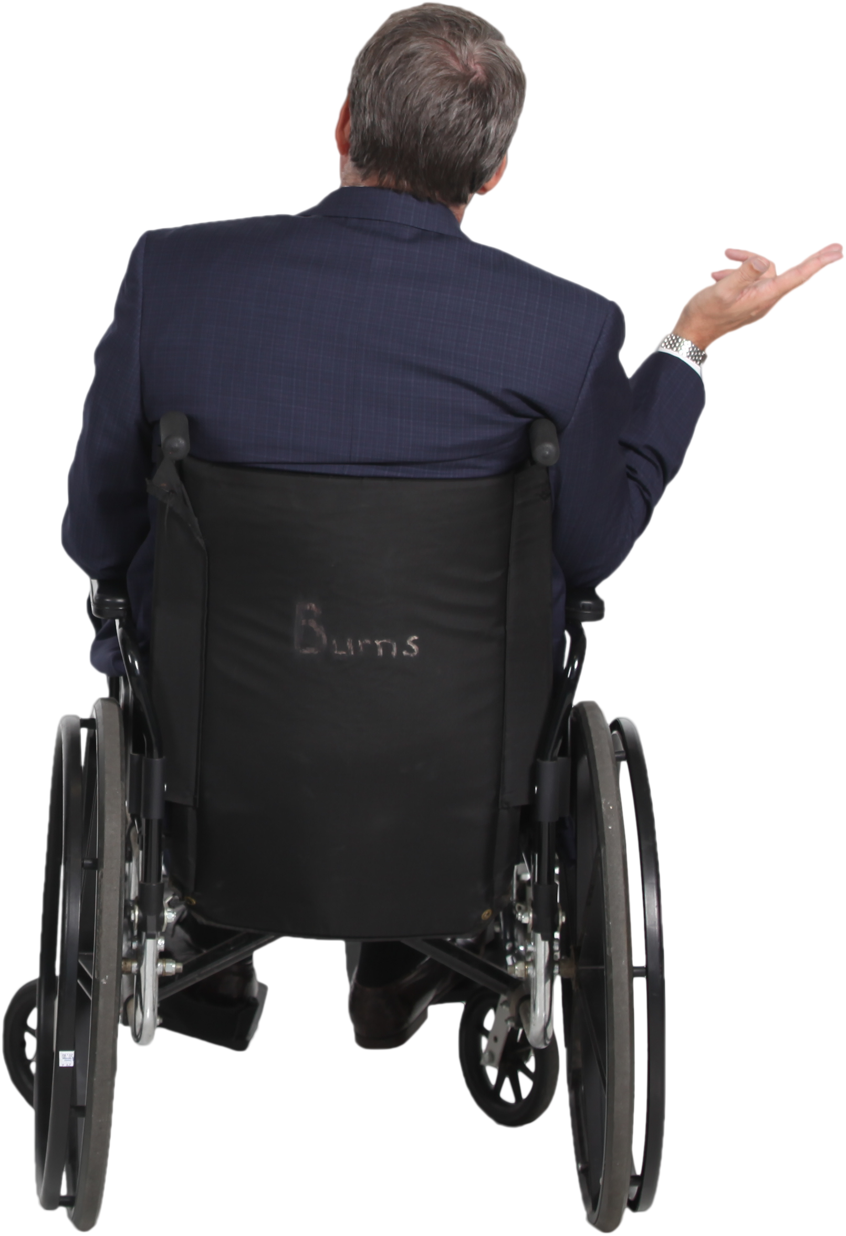
DISCUSSION
What did you think or feel during the game?
What were your greatest frustrations?
Notes:
Happiness Frustration Sadness Pride?
If the question arises regarding different versions/rules, acknowledge it but move on

Slide 42
DISCUSSION
How many think there were different versions of the game?
If you don’t think there were different versions, then what else might have been going on?
Notes:
Not learning the rules correctly
Not very good at cards
Cheating

Slide 43
There were Different versions at each table
Highest card wins.
Team 1 – Highest card of original suit wins.
Team 2 –Spades were trumps.
Team 3 – Hearts were trumps.
Team 4 – Clubs were trumps.
Etc.

Slide 44
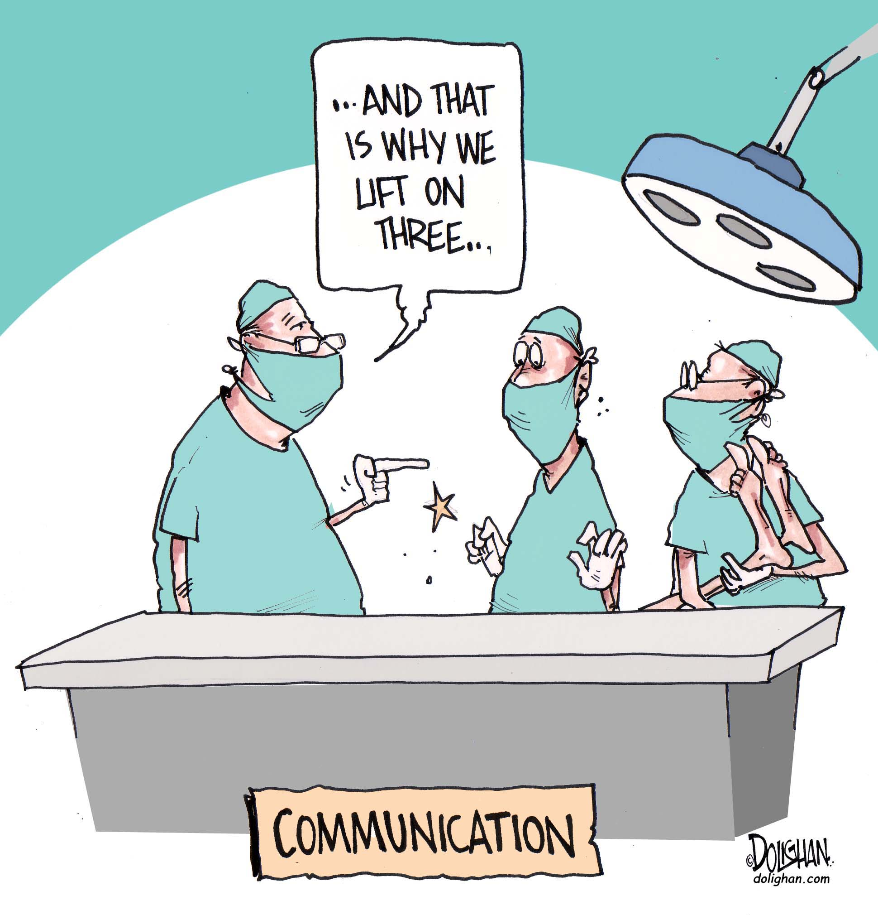
DISCUSSION
What specific real-life situations does this activity simulate?
Tracey Leigh Mathis Zeiner
Notes:
“1, 2, 3w/Lift” vs “1, 2, 3” then Lift

Slide 45
DISCUSSION
Have you ever experienced a situation where there were “rule differences” that you didn’t know about?
How did your view of things change once you became aware of the difference?
In retrospect, how could you have handled the situation differently?
Notes:
Monopoly: Written rules that come with the game…Unspoken rules that have become very common:
Land right on Go collect $400
Free Parking pays well as some put fines & taxes there.
Players can’t collect rent while they are still in jail, which makes jail painful.
4. Snake eyes pays $500

Slide 46
DISCUSSION
What does the game experience suggest about what to do when you are in this type of situation in the real world?
(Try to remember what you did during the game that worked.)
Notes:
Eye contact Smile Stop/Wait Breathe

Slide 47
DISCUSSION
What is the most important thing that you learned after playing the game?

Slide 48
The core competencies addressed during this activity:
Domain 1- Values/Ethics for Interprofessional Practice: Work with other professionals to maintain climate of mutual respect & shared values.
Embrace diversity & individual differences (patients, populations, & HC teams).

Slide 49
The core competencies addressed during this activity:
Domain 2 - Roles & Responsibilities: Use knowledge of your role & those of other professions to assess & address healthcare needs of those served.
Being able to explain those roles & responsibilities & how the team works together to provide care.

Slide 50
The core competencies addressed during this activity:
Domain 3 - Communicate with patients, families, communities, & other HC professionals in a responsive & responsible manner that supports a team approach.
Choose effective communication tools & techniques, including information systems & communication technologies, to facilitate discussions & interactions that enhance team function.
Organize & communicate information in a form that is understandable, avoid discipline-specific terminology when possible.
Recognize how one’s own uniqueness, including experience, expertise, culture, power, & hierarchy w/i the team, contributes to effective communication, conflict resolution, & positive interprofessional working relationships.

Slide 51
The core competencies addressed during this activity:
Domain 4 - Teamwork: Apply relation-building values & principles of team dynamics to perform effectively in different team roles to provide care that is safe, timely, efficient, effective, & equitable.
Integrate knowledge of other professions to inform care decisions, while respecting patient & community values & priorities/preferences for care.
Apply leadership practices that support collaboration & team effectiveness.
Engage self & others to constructively manage disagreements about values, roles, goals, & actions that arise.

Slide 52
Now what…?
Identify the needs related to Interprofessional Education and Practice in each discipline:
Watch for our survey coming to you soon! Be thinking…What information about other professions would have helped you be a better practitioner had you known about it earlier?
Be on the lookout for the new IPE website coming soon to provide you with resources such as pre- & post-tests related to IPE learning and forms to help you develop an IPE activity.
The IPE task force is currently developing IPE experiences that are embedded in our curriculum…not just a one-day event.

